Slide 1


Evaluation Warning : The document was created with Spire.Presentation for .NET
S/4HANA Technical Proposal
presented to
Jammy Test
ProAcc - Digital Transformation Solution for S/4HANA Migration

Slide 2



Promantus Global Presence
Evaluation Warning : The document was created with Spire.Presentation for .NET
US Based Global IT firm since 2011
Revenue ~15m USD
200+ Associates across the Globe
IT Consulting and Advisory Services
India
USA
Innovation Centre – Chennai
Delivery Centres – Bangalore, Chennai and Gurgaon
Global HQ – Raleigh, North Carolina
Innovation Centre – Raleigh, North Carolina
Delivery Centre – Washington DC
Europe
Europe HQ – Copenhagen, Denmark
Delivery Centre – Copenhagen, DK
Delivery Centre – Frankfurt, Germany
Promantus Inc, a US based consultancy IT Service provider, having global head quarter in Raleigh, North Carolina, established in 2011. It has European operation based out of Copenhagen and Global Delivery centres based out of India (Gurgaon, Bangalore and Chennai).

Slide 3
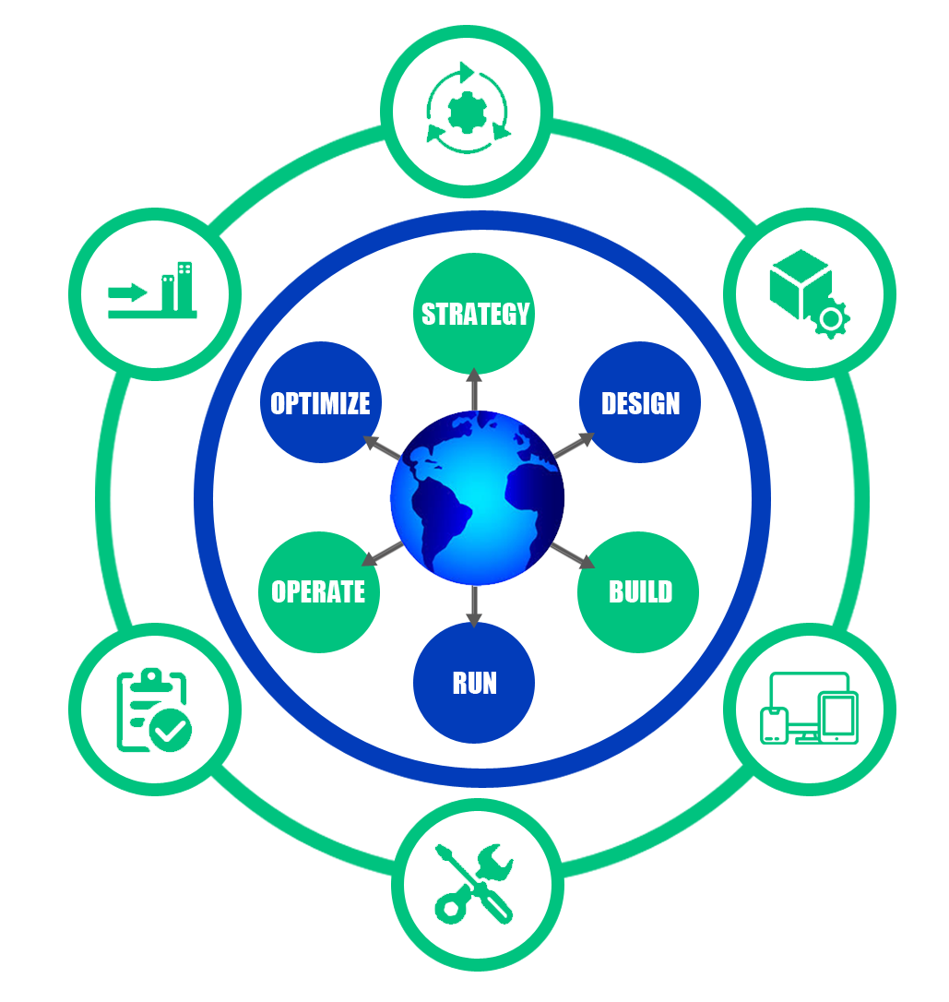

Promantus’ SAP Profile
Evaluation Warning : The document was created with Spire.Presentation for .NET
Implementation
10+ HANA Projects
150+ FIORI apps for 10+ customers
Proof of concept programs for customers to experiment HANA
50+ HANA certified consultants
HANA innovation labs for PoC’s, demo’s, internal development & training
Partner solution for full migration to S/4HANA
SAP Silver Partner
Promantus is highly specialized in Treasury Management, also having a co-selling and implementation partnership with Kyriba for North America and for Northern Europe
Expertise in SAP S/4HANA migration, EWM, TM, FSCM, Central finance, SuccessFactors, APO, IBP, GRC and FPSL (Analyzer)
Migration & Transformation
Application Management
Testing
Application Development and Integration
Application Operations
“Promantus as systems integrator also offers customers the ability to secure a seamless integration
with their SAP ERP system and other disparate applications“

Slide 4

Enabling the Cost Transformation
Evaluation Warning : The document was created with Spire.Presentation for .NET
CURRENT STATE
DESIRED STATE
28%
Drive Business
Innovation
Cost Reduction
Drive Business
Innovation
Streamlined Business Processes
Advanced Application Platform
Simplified Consumption Model
72%
”Keep the Lights On”
Digital Transformation
Projects
”Keep the Lights On”
Cost Reduction
Source: IDC

Slide 5
Why Transformation Now?
Evaluation Warning : The document was created with Spire.Presentation for .NET
Why S/4HANA?
Why S/4HANA Transformation Now?
Data simplification
01
02
High volume transactions
Digital Transformation is taking place with the rocket speed and it is shaping new digital economy
ECC goes into maintenance
As per SDF and Gartner, the resource base will sustainably transition to S/4HANA until 2021
Migration to S/4HANA is predicted from 2021 by Gartner
Implementation and conversion price will increase substantially in coming years
ECC life-time prolongation is good for IT and bad for business
04
Improved performance
Increased
flexibility
03
Optimized workflows
06
Real time data analysis
05
Improve your Manufacturing Cycle Time
Rate
Enhanced user experience
08
Flexibility to change
07
Rapid integration of data
10
Faster deployment
09

Slide 6
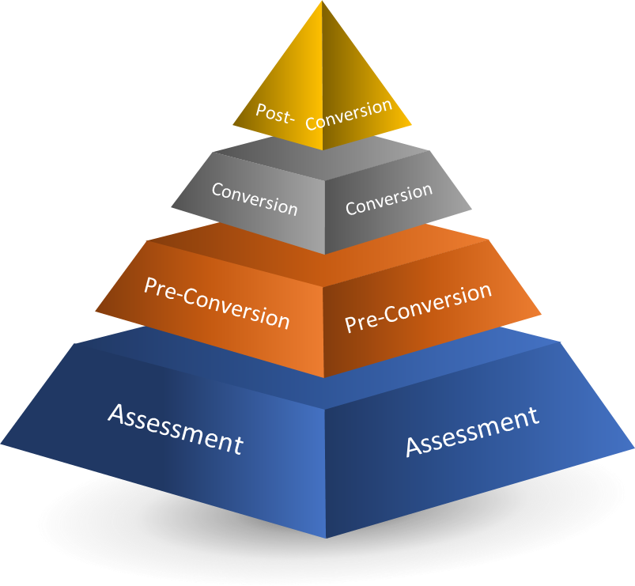
How we Accelerate S4HANA Transformation?
Evaluation Warning : The document was created with Spire.Presentation for .NET
ProAcc – the digital transformation framework solution for S/4HANA transformation
Automates all the phases of migration, with specially designed toolset; takes care of all tasks of assessment, pre-conversion, conversion, post-conversion and validation in a sequential manner with process validation
Delivers a detailed Assessment report that includes tailored recommendations for optimizations and alternate scenarios based on current state and future state analysis
Provides single view Dashboard – from discovery to go-live and acts as a single repository including pre-requisite checks, customer code analysis, data management, configuration checks and reconciliation reports
Our Modular approach towards the S/4HANA transformation can help organizations to decide their conversion roadmap based upon their specific business needs – adopt, move, merge, harmonize, etc.
“ProAcc not only automates the S/4HANA migration process but it also cuts through the complexity, removing manual processes to reduce the cost and minimize the risk; and in turn accelerate the S/4HANA adoption through the systematic and sequential processes.”

Slide 7
Our Migration Approach
Evaluation Warning : The document was created with Spire.Presentation for .NET
Findings Validation
Key findings review with subject matter experts – Impact on business processes
RICEFW and customization objects analysis – Impact on custom code
Reporting, Deliverable preparation
Impact Analysis
Integrate Promantus ProAccelerator tool with Source System
Run and analyze Transformation Navigator
Readiness checks and Promantus HANA assessment tools
Questionnaire and evaluations
Share the extracts and files to Promantus
Planning
Determine scope of evaluation
Identify preliminary business drivers
Information request / review:
Existing RICEFW list
Landscape / architecture
Business process list
Report & Recommend
Execute - Validate
Execute - Discover
Plan - Assess
Plan - Prepare
Roadmap Plan
Current / future state landscape and architecture
S/4HANA Roadmap and transformation strategy document
Business Value
Executive presentation & summary report
Next steps for S/4HANA Engagement
Workshops
S/4HANA overview presentation
Sponsor interview(s)
Selective S/4HANA demos
Discovery Workshops:
Landscape and architecture
SAP modules
RICEFW & Customizations
Key processes
Transformation opportunities
Remote evaluation, analysis and deliverable creation
Preparation
Remote preparation
Review system release and versions.
Business functions active and add-ons
“The assessment phase of the project will lead to a detailed roadmap and a business case that identifies the quantitative and qualitative benefits of the improvement initiatives”

Slide 8
Current Landscape - Jammy Test
Evaluation Warning : The document was created with Spire.Presentation for .NET
la_q1: no;
la_q2_1 : http://google.com;
la_q2_2: yes;
la_q2_3: no;
la_q2_4: no;
la_q2_5: no;
la_q2_6: yes;
la_q3: no;
la_q4_1: EHP4 FOR SAP ERP 6.0 / NW7.01;
la_q4_2: DB2 FOR LUW 10.5 64-BIT;
la_q4_3: LINUX SUSE SLES11/POWER 64BIT;
la_q4_4: SAP KERNEL 7.20 EXT 64-BIT;
la_q5: Less than 250 GB;
la_q6: SOLMAN 7.2 ;

Slide 9
Current Architecture - Jammy Test
Evaluation Warning : The document was created with Spire.Presentation for .NET
SAP Landscape and Applications:
Systems / Clients
Development System
QXX
Quality Assurance System
Productive System
DXX
PXX
Client XXX Golden / Customizing / Development
Client XXX Test / Validation
Client XXX Productive
Jammy Test SAP XX Systems
STMS
STMS
Installed Product Versions and Releases for the Applications
Product | Release
SAP ERP APPLICATION | Promantus - 2005 (ERP 6.0)
SAP NETWEAVER | Promantus - SAP EHP2 FOR SAP NETWEAVER 7.0
EHP7 FOR SAP ERP 6.0 | Jammy Test - EHP7 FOR ERP 6.0
IBM DB2 (Database) | Jammy Test - DB6 / 09.07.0011
Windows 2012 | Jammy Test - 6.2 On-Premise, 2012
SAP Kernel; SAINT/SPAM | Jammy Test - 722_REL; 65

Slide 10
Scope of Work
Evaluation Warning : The document was created with Spire.Presentation for .NET
Copy of ECC PRD instance to Sandbox
Solman 7.2 new implementation & Installation of Evaluation System
Copy of ECC PRD instance to Sandbox
Performing mandatory system checks for system conversion
Performing pre-conversion checks
Analysis of the list of custom objects impacted by the conversion
System conversion of the Sandbox ECC system into S/4 1909
Post conversion and data migration and validation for FI and Logistics
Code changes required for adoption of custom object
Develop the Reporting strategy for existing XX reports/dashboards using Embedded Analytics
Activation of up to 50 Fiori applications from list of SAP
Train the Trainer approach is followed with 4 sessions each from Basis, Finance , Logistics and supporting Modules , a detailed training plan will be circulated before the training starts.
Phase -2
Performing Pre-conversion checks
Code changes required for adoption of custom objects
System conversion of DEV, QA and Prod from ECC to S/4
Operate system and database upgrade to meet the prerequisite for conversion.
Setting up Production support landscape and change freeze
Post conversion and data migration for FI and Logistics
Implement Embedded Analytics to replace existing reports
Data Validation from ECC to HANA
Testing the process
Testing the new HANA Functionalities.

Slide 11
Project Assumption and Scope Exclusion
Evaluation Warning : The document was created with Spire.Presentation for .NET
Copy of ECC PRD instance to Sandbox
Jammy Test would provide a recent copy of the Production Data for being copied to the Sandbox instance. Hardware for the Sandbox conversion will be comparable to the PRD hardware.
Necessary documentation regarding any specific business process / configuration in the existing SAP system would be provided to the Project team upon request
All necessary Software / Database and Hardware licenses as may be required for performing the conversion shall be procured by Jammy Test.
System access required to all SAP applications shall be arranged by Jammy Test where such access is required for testing the Integration between applications post the conversion process
We assume that the onsite project team will work from Jammy Test premises where project infrastructure in form of system hardware, LAN, internet connectivity, communication facilities, meeting rooms etc. will be provided by Jammy Test to the project teams
Timely availability of process owners and stake holders will be ensured by Jammy Test.
Solman 7.2 will be implemented with only basic configurations to be used to monitor S//4 landscape
Code Freeze , Once the Conversion Phase Kicks Off.
Exclusion:-
Any task or activity relating to configuration in ECC system, that is not required for S/4 Hana Conversion
Any task or activity to be carried out on any non-SAP systems for the purpose of testing integration
Testing or modification of any data interfaces to SAP ECC or S/4 HANA, except for such testing as may be required to verify the correctness of the system conversion process
Any additional developments other than the existing custom objects identified for adjustment during the Conversion
Procurement of licenses
Integration with any other third-party system other than required for scope of work
Any other things not explicitly mentioned in the scope are out of scope

Slide 12
S/4HANA Conversion Roadmap
Evaluation Warning : The document was created with Spire.Presentation for .NET

Slide 13
S/4HANA Conversion Approach
Evaluation Warning : The document was created with Spire.Presentation for .NET

Slide 14
Proposed Proof of Concept (PoC)
Evaluation Warning : The document was created with Spire.Presentation for .NET
In order to document the efficiency of ProAcc, we offer potential clients a 3-tier process:
BASELINE ASSESSMENT (BA)
Duration: 4-5 days
Result: Business case and initial roadmap for migration
Proposal for comprehensive assessment
2. COMPREHENSIVE ASSESSMENT (CA)
Duration: 4-6 weeks
Result: Detailed assessment of the current landscape (analysis) Migration Roadmap – staggered approach
Application and Hardware scoping for S/4HANA
3. TRANSFORMATION/MIGRATION PROJECT
Duration: 3-6 Months
Result: Migration of SAP ECC/ERP to S4HANA as per the agreed scope
USING THE
TRADITIONAL
METHODS
RESOURCES
USING THE
ProAcc SOLUTION
TIME
”Optimized resourse base for a shorter time leads a win-win situation both reducing complexity and resulting in higher quality with speed”

Slide 15
S/4HANA POC Objective
Evaluation Warning : The document was created with Spire.Presentation for .NET
S/4HANA Assessment Roadmap
The S/4HANA Assessment service, part of Emergys portfolio of consulting services, provides Butterball with a roadmap as well as an independent & objective review of the overall state of your S/4 investment.
Assessment Service Offering include the following:
A recommended roadmap for the S/4HANA initiative – Greenfield / Brownfield / Bluefield approach.
A comparative analysis snapshot of various options to consider along with the priorities, business value proposition, dependencies, resource-estimates and recommended timelines.
An assessment of critical business processes for productivity improvements.
Examine business procedures and provide a high-level review of configuration and customization involved, and its impact on the planned S/4HANA transformation.
Provide an assessment of the SAP S/4HANA infrastructure needs to maximize ERP optimization.
Note: Typically the assessment covers a short duration and an intensive study with clear goal of getting detailed understanding of various key factors - currently being done as well as proposed.

Slide 16
Timeline - Baseline Assessment
Evaluation Warning : The document was created with Spire.Presentation for .NET
 |  |  | Baseline Assessment Schedule
Task Description | Responsibility | Day-0 | Day-1 | Day-2 | Day-3 | Day-4 | Day-5
Plan
Define Business Initiative | Client/Promantus | X
Prepare Preliminary Questionnaire | Promantus | X
Conduct Prep Tasks | Promantus | X
Preliminary understanding of the Current System (SAP Landscape) | Promantus |  | X
Evaluate
Conduct Workshop - S/4HANA Overview (Presentation) | Promantus |  | X
Basic understanding of critical business processes | Client/Promantus |  | X
Identify the current setup and Migration key considerations | Client/Promantus |  |  | X
Run basic programs to identify System readiness | Promantus |  |  | X
Evaluate impact of the results considering:
Complexities, Dependencies and Risks | Promantus |  |  | X | X
Resource Estimates and Costs | Promantus |  |  | X | X
Document Results
Top areas to consider in document | Promantus |  |  |  |  | X
Categorize and prioritize S/4HANA Readiness tasks | Promantus/Client |  |  |  |  | X
Develop recommended S/4HANA - High Level Plan | Promantus |  |  |  |  | X
Final Presentation
Finalize Assessment Documentation | Promantus |  |  |  |  | X | X
Presentation of Results | Promantus |  |  |  |  |  | X

Slide 17
Timeline - Comprehensive Assessment
Evaluation Warning : The document was created with Spire.Presentation for .NET
 |  |  | Baseline Assessment Schedule
Task Description | Responsibility | Day-0 | Day-1 | Day-2 | Day-3 | Day-4 | Day-5
Plan
Define Business Initiative | Client/Promantus | X
Prepare Preliminary Questionnaire | Promantus | X
Conduct Prep Tasks | Promantus | X
Preliminary understanding of the Current System (SAP Landscape) | Promantus |  | X
Evaluate
Conduct Workshop - S/4HANA Overview (Presentation) | Promantus |  | X
Basic understanding of critical business processes | Client/Promantus |  | X
Identify the current setup and Migration key considerations | Client/Promantus |  |  | X
Run basic programs to identify System readiness | Promantus |  |  | X
Evaluate impact of the results considering:
Complexities, Dependencies and Risks | Promantus |  |  | X | X
Resource Estimates and Costs | Promantus |  |  | X | X
Document Results
Top areas to consider in document | Promantus |  |  |  |  | X
Categorize and prioritize S/4HANA Readiness tasks | Promantus/Client |  |  |  |  | X
Develop recommended S/4HANA - High Level Plan | Promantus |  |  |  |  | X
Final Presentation
Finalize Assessment Documentation | Promantus |  |  |  |  | X | X
Presentation of Results | Promantus |  |  |  |  |  | X

Slide 18
Timeline - Conversion
Evaluation Warning : The document was created with Spire.Presentation for .NET

Slide 19
Value Proposition - Up to 50% Cost Saving
Evaluation Warning : The document was created with Spire.Presentation for .NET
Comprehensive Support
Tool for the digital transformation with project monitor and cockpits.
Tested with compliance with multiple client systems
Personalized Approach
Tailor-made assessment and transformation approach for every unique requirement.
Single tool from assessment to go-live, considering different scenarios and scale.
Sequentially Automated Process
A step-by-step foot walk guidance from assessment to go-live.
Select block methodology approach
Built-in ABAP tool to handle RICEF objects
Rapid Implementation Journey
Speed with secured way
Cost efficient through out the project
Migration & conversion of complete data sets
Minimal Disruption
No/Minimal Interruptions to critical business processes
Meets all goals on transitioning

Slide 20
Global Delivery Proposition
Evaluation Warning : The document was created with Spire.Presentation for .NET
WHAT?
WHERE?
HOW?
WHO?
WHEN?
Project Scope
OS and DB upgrade to meet the pre-requisite
Conversion from SAP ECC to S/4 HAN
Support and consulting
Solman 7.2 Implementation
Delivery Capability
Leveraging Promantus’ global delivery network model with follow the sun 24x7 coverage
Onsite, offshore & nearshore
24x7 on-call support
Multi-vendor model
On demand staffing
Offshore delivery centers in North America, India, Europe, Singapore, Hong Kong
Client Success - Methodology
PMO to drive through efficient governance
Productivity & quality focus
Onsite – Offshore Model
Database Migration Option (DMO) Methodology
Institutionalize knowledge
Resource Capability
Project Manager
Cross Functional SMEs
Technical SME
Data conversion & testing CoE
SWAT team to support e-Down
Management team for Governance.
End user functional support and training
Availability
Fixed budget/timeline implementation and testing
Total duration is 8 months
12 weeks for Sandbox conversion
T&M SoW
20 weeks for SAP S/4 HANA conversion
Source: IDC

Slide 21
Potential Risk and Mitigation
Evaluation Warning : The document was created with Spire.Presentation for .NET
Copy of ECC PRD instance to Sandbox
Context | Risks | Mitigation
Limited Business Downtime Window | Extended Business Downtime | Multiple dry runs with copy of PRD to optimize • Estimate the preprocessing time (uptime) and business downtime in the dry-runs and refine approach Clear milestones during Cutover Go-No Go decision points Escalation with SAP / HW vendor for issues Possibility of business downtime to start earlier during cutover.
Production Break Fix Transports | Version of objects in DEV & QAS not in-sync with version in PRD (after S/4) conversion | Stringent Change control process Production fixes are reviewed for applicability to S/4 and manually redone in S/4 Project stream and moved forward Tight Integration between the S/4 Project team and Production Support team
Other Projects in Production Support Stream | Unstable environment for the conversion | Change release windows will be fixed prior to project start Before DEV conversion Before QAS conversion Production freeze

Slide 22
Roles and Responsibilities
Evaluation Warning : The document was created with Spire.Presentation for .NET
Copy of ECC PRD instance to Sandbox
Roles | Responsibilities
Project Manager (Team Leader) | Project planning Person primarily responsible for driving the project Responsible for the technical solution and architecture Status reporting of the project Manages project risk and track to closure
SAP Functional Consultant | Drives business requirement understanding, specification and analysis Extensively tests all the Finance processes end to end post the system conversion Carries out all the functional testing for Operational Reporting Carries out all the functional testing for reporting for Business Planning and consolidation Support in UAT Provides functional Early Life Support Tests the application to ensure proper functionality.
Basis Consultant | Installs SAP database Plans for backup and recovery of database information Optimizes the performance of the database Ensures database level information security Troubleshoots the errors Controls user access to the database
ABAP Consultant | Develops ABAP code Carries out the code changes required for adopting custom code into S/4 HANA Tests the application to ensure proper functionality Works with the Basis consultant in the setup of SAP FIORI UI

Slide 23

Contact Us
Evaluation Warning : The document was created with Spire.Presentation for .NET
USA (Global Head Office)
8521 Six Forks Rd., Suite 108,
Raleigh, North Carolina - 27615
Tel: +1 919 335 5511
E-mail: info@promantusinc.com
Europe Head Office
Strandvejen 125, DK-2900 Hellerup
Copenhagen, Denmark
Tel: +45 2092 0370
E-mail: europe@promantusinc.com
India Global Delivery Center
6th Floor, Orchid Tech Space, STPI
Cyber Park, Bangalore, India
Tel: +91 80 66186186
E-mail: info@promantusinc.com
Website: www.promantusinc.com

